Slide 1
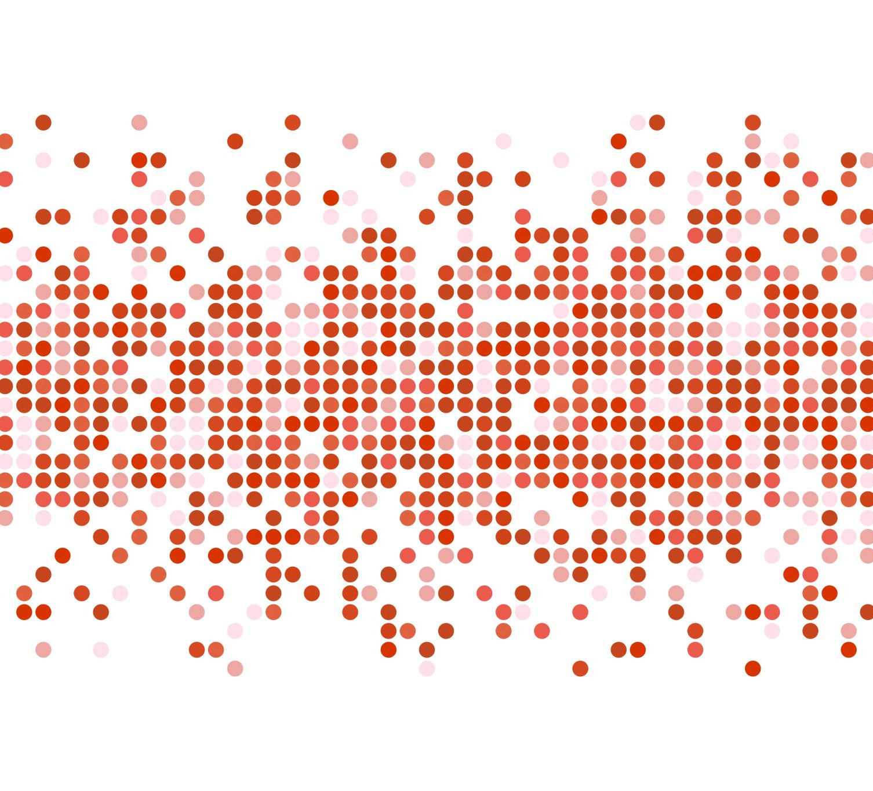
State of Victoria’s Crime Data Visualisation pre-COVID and during COVID
Berta Devenyi Phuong Tieu

Slide 2
Objectives of the Study
Data scope, cleanup and add-on
Compare the last 4 years of crime offences in Victoria, 2019-2022, pre-COVID and during COVID.
Crime and safety status in different LGAs/suburb.
Comparison of the 10 most committed crimes against people in different LGAs in 2019, 2020 & 2021 .
Filtering offence data by Year and LGA and visualising this data.
Taking Heroku’s free data capacity allowance into consideration we decided to add:
- Table1, Police Region data, renamed as region_incident, data scoped 2019-2022, dropped ‘Total’ rows.
- Table2, Local Government Area offence data, renamed as lga_offence, data scoped 2022.
- Table5, Local Government Area Charge status data, renamed as charge_status, data scoped 2019-2022.
- Table 6, new add-on to show summary of LGA offences base on offence type renamed as lga_offence_summary, for easier data retrieval and visualization.
Source of the data:

Slide 3
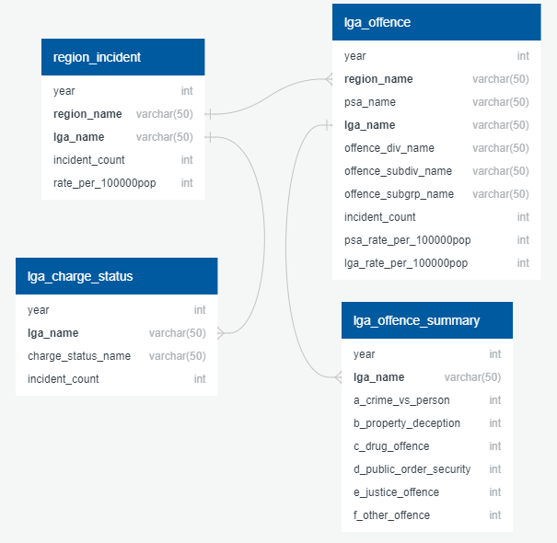
Data Exploration In Victoria in high level, we have 4 Police Regions, plus Justice Institutions and Immigration Facilities and Unincorporated Vic. Each Police Region has multiple Police Service Area (PSA, total of 54) which provide law and order services to Local Government Area (LGA, total of 79) . Each offence can be break down to division, sub-division and sub-group. Each year the Victoria Crime Statistic data were released in March.
Entity Relation Diagram

Slide 4
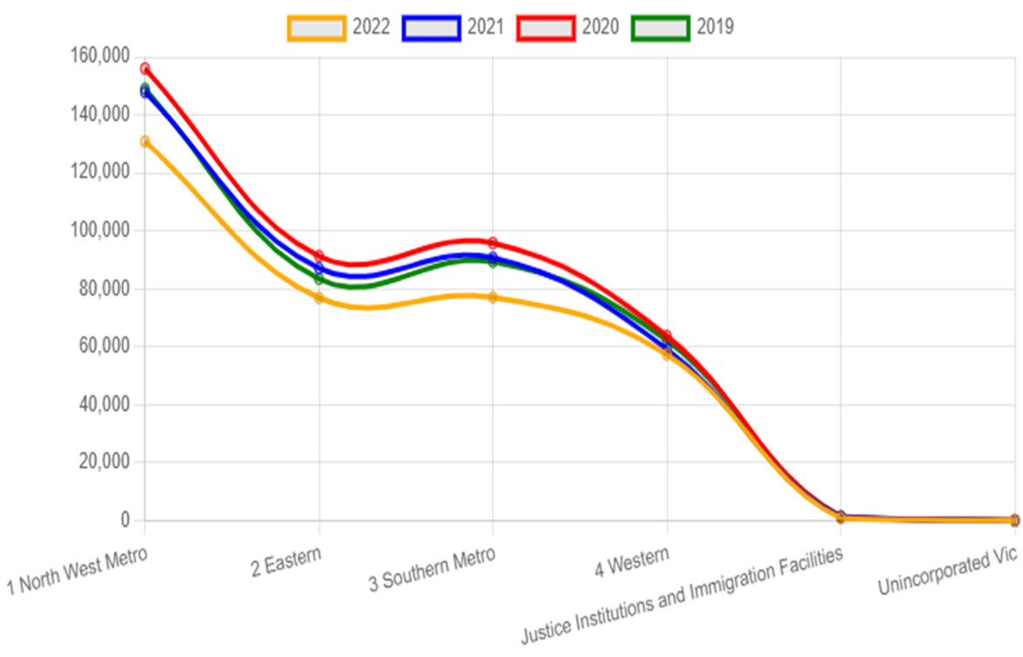
Regional Offences 2019-2022
Data Analysis This line chart shows 4 years of Victoria’s offence data. 2020 had the highest counts, follow to it was 2021 and 2019. The number of offences are lowest in 2022.
Technical background: This line chart was created using chartjs, one of javascript’s libraries. When the chart first load, tension setting will the line soften, it has delay animation effect. Upon clicking on the year labels will toggle hide or show the line of that year.
Hover over a data point will show region’s name and offence count.

Slide 5
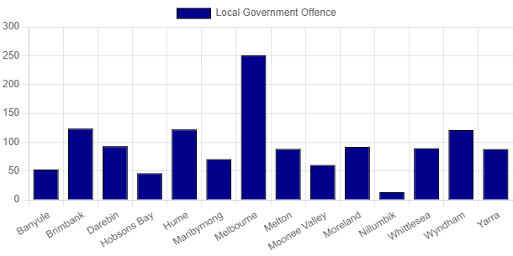
Data Analysis In 2022, Melbourne had the highest number of offences; next to it were Brimbank and Wyndham, though they had almost half of the number of crimes in Melbournce. The LGAs are under government of Police Region ‘1 North West Metro’ that has 14 LGAs. Technical background: This bar chart was created using chart js, one of the javascript library. When the chart first load, it has delay animation effect. Upon clicking on the label ‘Local Government Offence’ will toggle hide or show the chart. Hover over a bar will show LGA’s name and its incident count.
Local Government Area Offences base on Police Region

Slide 6
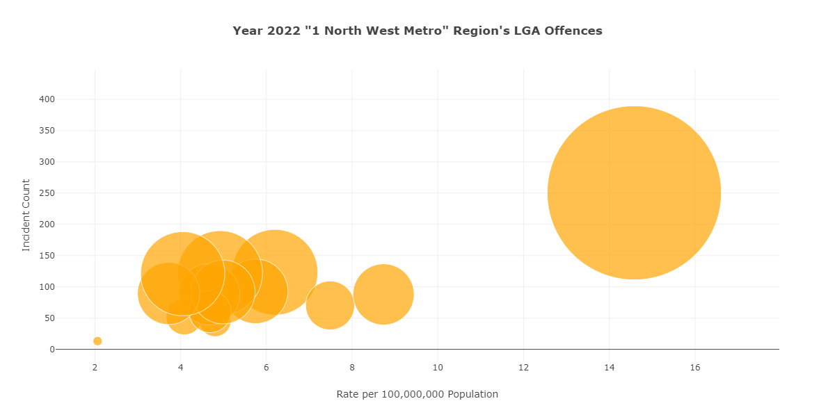
Data Analysis In 2022, Melbourne had the highest number of offences; next to it were Brimbank and Wyndham. Technical background: This bubble chart was created using plotly. Hover over a bubble will show LGA’s name and its incident count.
Regional Local Government Offences

Slide 7
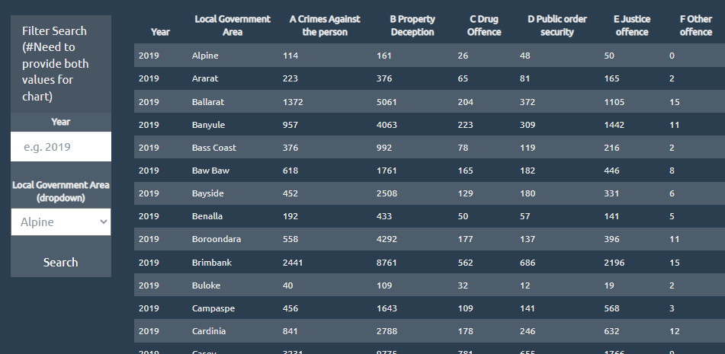
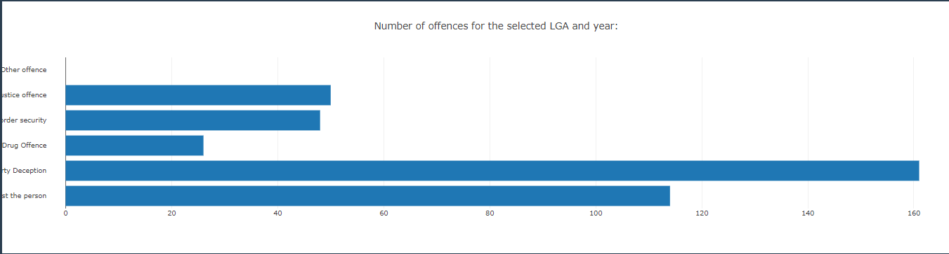
Offence Summary – List, Filter, Chart
Using offence_summary_df.csv the Offence Summary table is displayed, so the data can be listed filtered and charted by:
Year
Local Government Area
Offence types (A-F)
The LGA filter is populated from the data source as well (dropdown)
Filtering is possible by different fields (Local Government Area and Year)
Using the filters on the same page and Plotly, we display a bar chart representing the different offence types for a specific Local Government area for a specific year.
Technical Background:
List / Filter: Displaying the summary data loaded from CSV, using Javascript, HTML, CSS and D3 (policedata.html, policadata.js, policedata.css)
Chart: Javascript, Plotly, D3

Slide 8
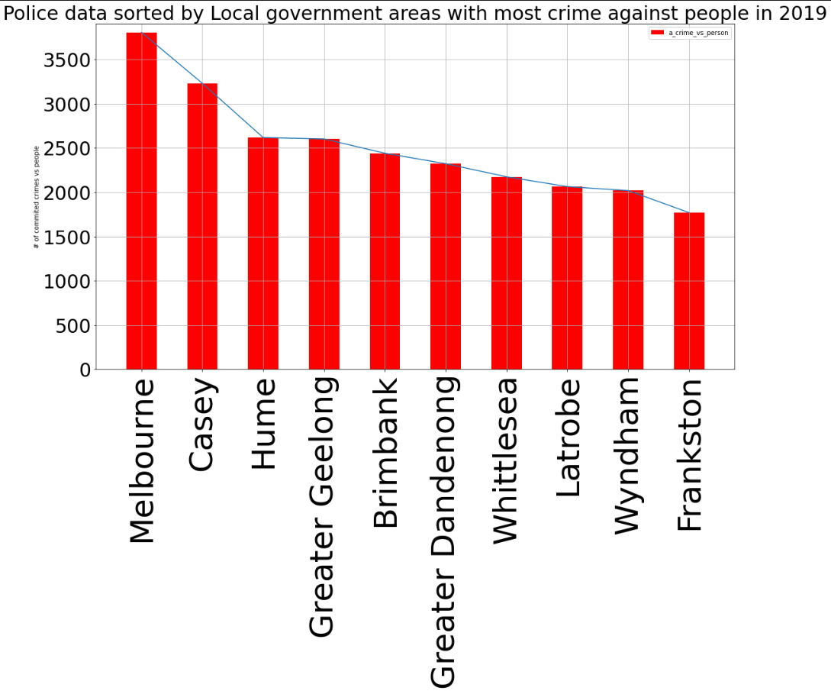

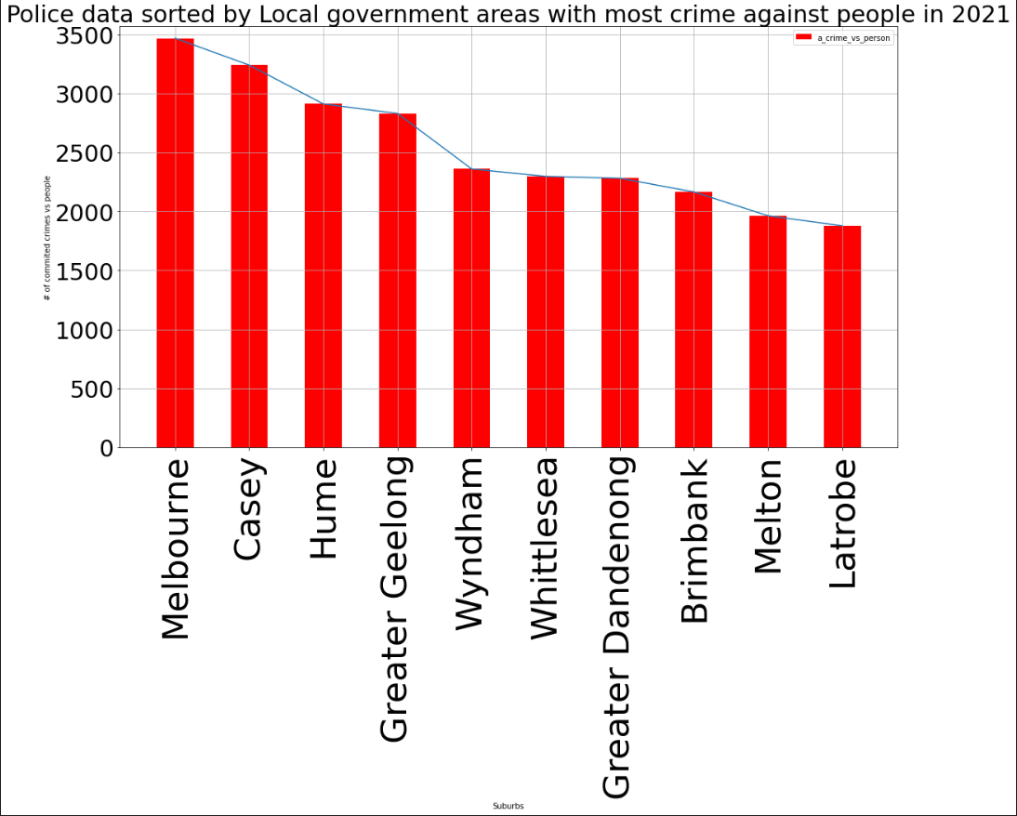
10 most committed crimes against people in different LGAs in 2019, 2020 & 2021 (Data analysis)
Technical Background: Python, Pandas, Matplotlib (policedata.ipynb)

Slide 9
Findings
In 2017 Victoria had the highest number of home theft and burglary in Australia.
If we compare individual LGAs with the highest number of crimes before COVID and during COVID, we can see that the number of crimes and the ranking hasn’t significantly changed.

